Slide 1

Character Writing Robot
TEAM 6
Team Details :
Amarjit Prasad (BE-EXTC)
Abhishek Kharche (BE-COMP)
Chinmay Pednekar (BE-COMP)
Vaibhav Naidu (BE-COMP)
SHIVAJIRAO S. JONDHALE COLLEGE OF ENGINEERING
DOMBIVLI

Slide 2
Project objective
The project objective is to explore the “writing capability of robots”
We program a Spark V robot ie. ATMEGA 16 based to write on a paper with pen
A mechanism makes the pen move in different directions
Input is given through user interface using XBEE (Based on zigbee protocol, IEEE 802.15.4)

Slide 3
Task Specifications
Making a robust robot body to hold the writing mechanism
Developing the mechanism with two arms rotated by stepper motors
Developing algorithm for character printing based on STROKE method
Making GUI for user to input character through keyboard
When finished printing one character lift the pen and move to next position and wait for input

Slide 4
Start
Flow Chart
Take next character from input string
Load line coordinates from memory
Proceed to start point and put pen down
Trace inbuilt path to final point and lift the pen
No
All lines of current alphabet traced ?
Yes
Move robot to next position
No
All characters in input string printed ?
Yes
Stop

Slide 5
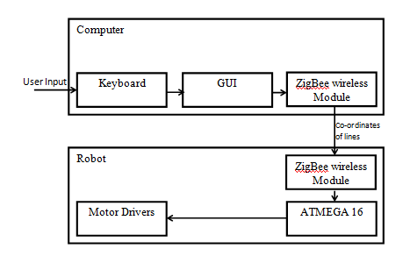
Functional Block diagram

Slide 6
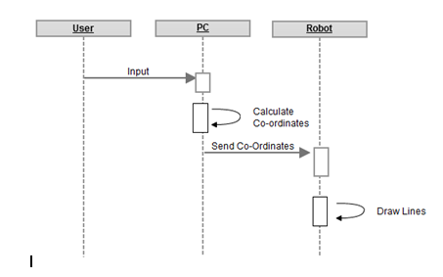
Sequence Diagram

Slide 7
Signal flow
User: User input text and the font size to the application (GUI) developed for the PC
PC: When the user inputs any string, the application running on the PC will generate an intermediate data to be passed to the Robot
Robot: The Robot will accept the data passed from the PC using a wireless ZigBee module. It will use the data passed from the computer to generate lines on the paper to form the characters in the input string.

Slide 8
Innovations
The character writing algorithm is self developed and is much easier to understand and implement than any other algorithm for character generation
The self developed writing mechanism is much cheaper and lighter than any other writing mechanism available in the market
We had to split the only motor driver present on SPARK V to drive two stepper motors simultaneously
We also designed an applet with animation for virtual demonstration of our project

Slide 9
Challenges
PROBLEM:
The problem with this mechanism is that when the arm moves from one point to
other, we have no control on how the motors will rotate between the given two
points. So the end result will not necessarily be a straight line. It will be some
arbitrary set of curves that we cannot even predict. Therefore it look like scribble.
SOLUTION:
To solve this problem we divide the line into 10 equal parts. The co-ordinates of
these intermediate points are calculated and 10 lines are drawn instead of one.
Now, though the line is crooked in between the effect will not be seen on the
entire character.

Slide 10
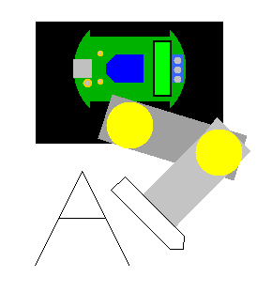
Task completed
Mechanism
The mechanism is mounted on the chassis .
Two motors are used, one for each axis.
A third motor will be used to move the pen up or down.

Slide 11
Mechanism

Slide 12
Line Tracing

Slide 13
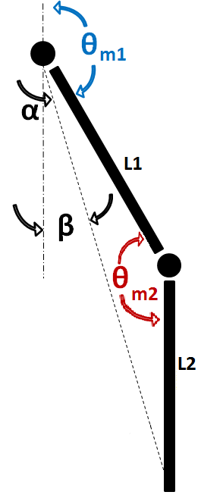
Working
L = √(X² + Y² )
L1 ² + L2 ² - L ²
cos θm2 = ----------------------
2 L1 L2
L1 ² + L ² - L2 ²
cos α = ----------------------
2 L1 L
Y
L
tan β = X / Y
θm1 = 180 - α - β
X

Slide 14
Character Mapping
X
(-50,0)
(0,0)
(50,0)
(-50,50)
(50,50)
Y
(-50,100)
(0,100)
(50,100)

Slide 15
Example
(-50,0)
(0,0)
(50,0)
Pen down
Line(-50,100, 0,0)
Line(0,0, 50,100)
Pen up
Line(50,100, -25,50)
(-50,50)
(50,50)
Pen down
Line(-25,50, 25,50)
(-50,100)
(0,100)
(50,100)

Slide 16
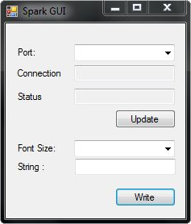
GUI
Visual C++
Select COM port at runtime
Check status of robot
Enter multiple characters at a time

Slide 17
Applet Simulation
The simulation is done on an applet designed for our project which shows virtual demonstration on how the robot is going to work.
It also suggests following parameters :
Assumptions
Performance
Results
Applet

Slide 18
Limitations
If we increase the font of character, it is not efficient because the lines are crooked which will be seen if the lines are large. So for drawing large characters, high precision motors are required and dividing each line segment into more small parts is the only solution.
The maximum area to which the robot can draw is limited by the length of its arm. The work environment of this arm is a semicircle of the radius defined by sum of length of both the links, Drawing characters that are larger than this will require changing the length of the arms.
All characters cannot be defined as a set of line segments. Some require only curves or are too small to be defined by lines eg: comma(,), full stop(.), brackets( (, ) ). Drawing these characters won’t be possible as long as we make this mechanism robust enough to draw curves.

Slide 19
Re-usability features
The main aim of IIT Bombay behind this project is to create libraries that can be used in future by anybody who is developing on a similar platform
This project is open source so anybody can implement this in their existing project
All the codes for the writing mechanism is uploaded on GitHub
The split motor driver module can be used in robots having lots of motors to drive

Slide 20
Future Enhancements
As there are some problem with the mechanism, if it is given more power and high torque motors then it would generate more precise characters.
To draw the characters we have to specify line coordinates which are processed through subroutines. This is a very hectic and time consuming task. If some character generation method can shorten the process then the robot would write real fast.

Slide 21
Thank You

